Slide 1

Chapter 7 Wireless and
Mobile Networks
Computer Networking: A Top-Down Approach 8th edition Jim Kurose, Keith Ross Pearson, 2020
Acknowledgement: Based on the textbook’s website: https://gaia.cs.umass.edu/kurose_ross/index.php
Notes:
Version History
8.0 (May 2020)
All slides reformatted for 16:9 aspect ratio
All slides updated to 8th edition material
Use of Calibri font, rather that Gill Sans MT
Add LOTS more animation throughout
lighter header font
4G/5G material completely updated; older 2/2.5/3G removed
8.2 (July 2023). Changes from 8.0:
minor updates and additional, including removing master/slave Bluetooth language
expansion, better graphics on wireless link characteristics
expanded, significant revisions of 4G/5G material (but not mobility)

Slide 2
Wireless and Mobile Networks: context
IMPORTANT
more wireless (mobile) phone subscribers than fixed (wired) phone subscribers (10-to-1 in 2019)!
more mobile-broadband-connected devices than fixed-broadband-connected devices devices (5-1 in 2019)!
4G/5G cellular networks now embracing Internet protocol stack, including SDN
two important (but different) challenges
wireless: communication over wireless link
mobility: handling the mobile user who changes point of attachment to network

Slide 3

Chapter 7 outline
IMPORTANT
Introduction
Wireless
Wireless Links and network characteristics
WiFi: 802.11 wireless LANs
Cellular networks: 4G and 5G
Mobility
Mobility management: principles
Mobility management: practice
4G/5G networks
Mobile IP
Mobility: impact on higher-layer protocols

Slide 4



















Elements of a wireless network
IMPORTANT
wired network
infrastructure

Slide 5





Elements of a wireless network
IMPORTANT
wireless hosts
laptop, smartphone, IoT
run applications
may be stationary (non-mobile) or mobile
wireless does not always mean mobility!
Smart sensors in a building are wireless but not mobile
wired network
infrastructure

Slide 6

Elements of a wireless network
IMPORTANT
base station
typically connected to wired network
relay - responsible for sending packets between wired network and wireless host(s) in its “area”
e.g., cell towers, 802.11 access points
wired network
infrastructure

Slide 7
Elements of a wireless network
IMPORTANT
wireless link
typically used to connect mobile(s) to base station, also used as backbone link
multiple access protocol coordinates link access
various transmission rates and distances, frequency bands
wired network
infrastructure

Slide 8
Characteristics of selected wireless links
IMPORTANT
14 Gbps
802.11ax
10 Gbps
5G
3.5 Gbps
802.11ac
802.11 af,ah
600 Mbps
802.11n
4G LTE
54 Mbps
802.11g
11 Mbps
802.11b
2 Mbps
Bluetooth
Indoor
Outdoor
Midrange
outdoor
Long range
outdoor
10-30m
50-200m
200m-4Km
4Km-15Km

Slide 9
Elements of a wireless network
IMPORTANT
infrastructure mode
base station connects mobiles into wired network
handoff: mobile changes base station providing connection into wired network
wired network
infrastructure

Slide 10
Elements of a wireless network
IMPORTANT
ad hoc mode
no base stations
nodes can only transmit to other nodes within link coverage
nodes organize themselves into a network: route among themselves

Slide 11
Wireless network taxonomy
IMPORTANT
single hop
multiple hops
host connects to base station (WiFi, cellular) which connects to larger Internet
host may have to relay through several wireless nodes to connect to larger
Internet: mesh net
infrastructure
(e.g., APs)
no base station, no connection to larger Internet (Bluetooth, ad hoc nets)
no base station, no connection to larger Internet. May have to relay to reach other a given wireless node MANET, VANET
no
infrastructure

Slide 12
Chapter 7 outline
Introduction
Wireless
Wireless links and network characteristics
WiFi: 802.11 wireless LANs
Cellular networks: 4G and 5G
Mobility
Mobility management: principles
Mobility management: practice
4G/5G networks
Mobile IP
Mobility: impact on higher-layer protocols

Slide 13
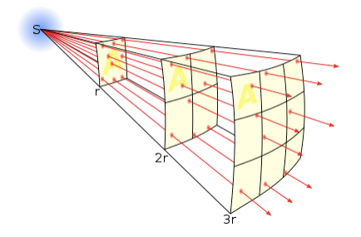
Wireless link characteristics: fading (attenuation)
IMPORTANT
Wireless radio signal attenuates (loses power) as it propagates (free space “path loss”)
Free space path loss ~ (fd)²
f: frequency
d: distance
higher frequency or longer distance
larger free space
path loss
Notes:
Wikipedia figure

Slide 14




Wireless link characteristics: multipath
IMPORTANT
multipath propagation: radio signal reflects off objects ground, built environment, arriving at destination at slightly different times
reflected path
line of sight
(LOS) path
reflected path

Slide 15
Wireless link characteristics: multipath
IMPORTANT
multipath propagation: radio signal reflects off objects ground, built environment, arriving at destination at slightly different times
Coherence time:
amount of time bit is present in channel to be received
influences maximum possible transmission rate, since coherence times can not overlap
inversely proportional to
frequency
receiver velocity
transmitted
pulses
time
received
LOS pulse
received
multipath
pulses
received
multipath
pulses
received
LOS pulse
received
pulse
time
T_{c}: coherence time

Slide 16
Wireless link characteristics: noise
IMPORTANT
interference from other sources on wireless network frequencies: motors, appliances
SNR: signal-to-noise ratio
larger SNR – easier to extract signal from noise (a “good thing”)
SNR versus Bit Error Rate (BER) tradeoff
given physical layer: increase power -> increase SNR->decrease BER
SNR may change with mobility: dynamically adapt physical layer (modulation technique, rate)
10⁻¹
10⁻²
10⁻³
BER
10⁻⁴
10⁻⁵
10⁻⁶
10⁻⁷
10
20
30
40
SNR(dB)
QAM256 (8 Mbps)
QAM16 (4 Mbps)
BPSK (1 Mbps)

Slide 17

Wireless link characteristics: hidden terminals
IMPORTANT
Hidden terminal problem due to obstacles
B, A hear each other
B, C hear each other
A, C can not hear each other means A, C unaware of their interference at B
Hidden terminal problem due to signal attenuation
B, A hear each other
B, C hear each other
A, C can not hear each other interfering at B
C
A
B
C
B
A
C’s signal
strength
A’s signal
strength
space

Slide 18
Chapter 7 outline
Introduction
Wireless
Wireless links and network characteristics
CDMA: code division multiple access
WiFi: 802.11 wireless LANs
Bluetooth

Slide 19
Review: FDMA and TDMA
Frequency
Frequency
User n
…
User 1
…
User 2
User 2
User n
User 1
Time
Time
First generation (1G) systems use Frequency Division Multiple Access (FDMA)
Most of second generation (2G) systems use Time Division Multiple Access (TDMA)

Slide 20
Code Division Multiple Access (CDMA)
IMPORTANT
Frequency
User 1
.
User 2
.
.
User n
Time
Code
Users share bandwidth by using code sequences that are orthogonal to each other
Some 2G and most 3G systems use CDMA

Slide 21
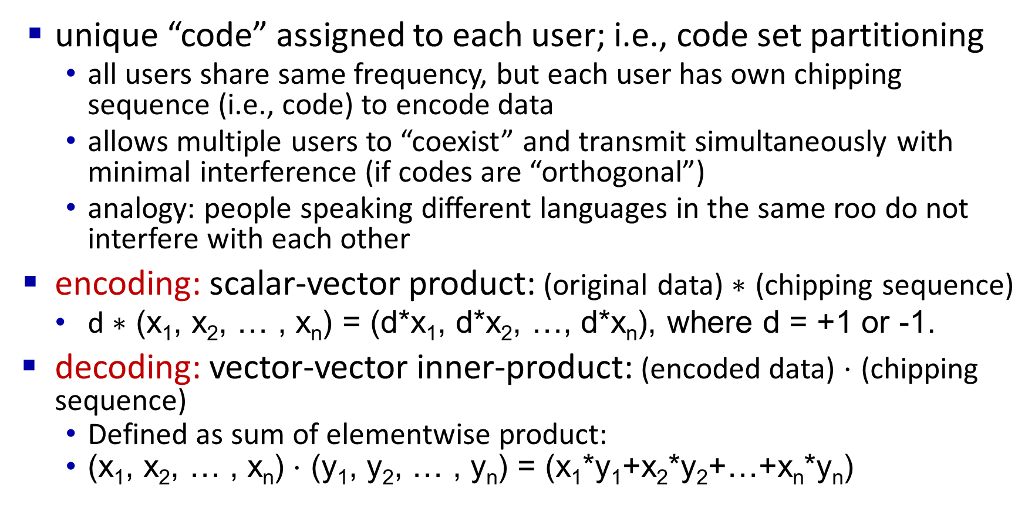
Code Division Multiple Access (CDMA)
IMPORTANT
unique “code” assigned to each user; i.e., code set partitioning
all users share same frequency, but each user has own chipping sequence (i.e., code) to encode data
allows multiple users to “coexist” and transmit simultaneously with minimal interference (if codes are “orthogonal”)
analogy: people speaking different languages in the same roo do not interfere with each other
encoding: scalar-vector product: (original data) $∗$ (chipping sequence)
d $∗$ (x₁, x₂, … , x_{n}) = (d*x₁, d*x₂, …, d*x_{n}), where d = +1 or -1.
decoding: vector-vector inner-product: (encoded data) $⋅$ (chipping sequence)
Defined as sum of elementwise product:
(x₁, x₂, … , x_{n}) $⋅$ (y₁, y₂, … , y_{n}) = (x₁*y₁+x₂*y₂+…+x_{n}*y_{n})

Slide 22
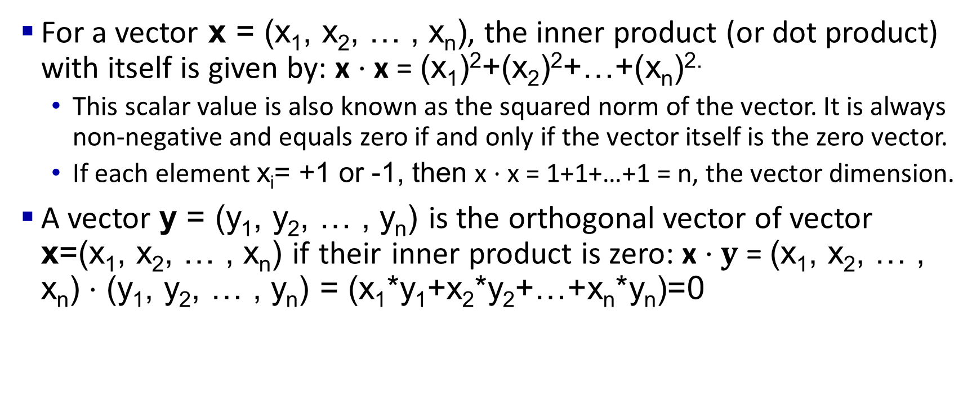
Vector-Vector Inner-Product, Orthogonal Vector
For a vector x = (x₁, x₂, … , x_{n}), the inner product (or dot product) with itself is given by: x $⋅$x = (x₁)²+(x₂)²+…+(x_{n})^{2.}
This scalar value is also known as the squared norm of the vector. It is always non-negative and equals zero if and only if the vector itself is the zero vector.
If each element x_{i}= +1 or -1, then x $⋅$x = 1+1+…+1 = n, the vector dimension.
A vector y = (y₁, y₂, … , y_{n}) is the orthogonal vector of vector x=(x₁, x₂, … , x_{n}) if their inner product is zero: x $⋅y$= (x₁, x₂, … , x_{n}) $⋅$ (y₁, y₂, … , y_{n}) = (x₁*y₁+x₂*y₂+…+x_{n}*y_{n})=0
Notes:
The square root of this value gives the Euclidean norm (or length) of the vector:∥v∥=v⋅v∥v∥=v⋅v​

Slide 23
Direct-Sequence Spread Spectrum CDMA
IMPORTANT
+1
+1
+1
+1
-1
-1
-1
Chipping sequence (Code): (+1,+1,+1,-1,+1,-1,-1,-1)
The 8-bit sequence 1*(+1,+1,+1,-1,+1,-1,-1,-1) encodes data bit 1 (corresponding to application bit 1).
The 8-bit sequence (-1)*(+1,+1,+1,-1,+1,-1,-1,-1) = (-1,-1,-1,1,-1,1,1,1) encodes data bit -1 (corresponding to application bit 0).
Spreading factor = Code length/data bit = 8
10-100 commercial (Min 10 by FCC), 10,000 for military
Two codes are orthogonal to each other, if their inner product equals 0.
Notes:
Signal bandwidth > 10 × data bandwidth
Code sequence synchronization
Z_{i,m}= d_{i}.c_{m}
-1*(1,1,1,-1,1,-1,-1,-1) = (-1,-1,-1,1,-1,1,1,1)
1*(1,1,1,-1,1,-1,-1,-1) = (1,1,1,-1,1,-1,-1,-1)
Correlation between codes ⇒ Interference ⇒ Orthogonal

Slide 24
CDMA encode/decode
IMPORTANT
Encoded data in slot 1:
-1*(+1,+1,+1,-1,+1,-1,-1,-1)
= (-1,-1,-1,+1,-1,+1,+1,+1)
channel output Z_{i,m}
Z_{i,m}= d_{i}.c_{m}
data
bits
d₀ = 1
1
1
1
1
1
d₁ = -1
1
1
1
-
-
-
-
1
-
-
-
1
-
1
1
1
1
1
sender
1
1
slot 1
channel
output
slot 0
channel
output
1
1
1
1
1
code
1
1
-
-
-
1
-
1
1
1
-
-
-
1
-
1
1
1
slot 1
slot 0
M
d_{i} = Σ Z_{i,m}.c_{m}
m=1
receiver
M
received
input
1
1
1
1
1
1
1
1
d₀ = 1
-
-
-
-
1
-
-
-
1
-
1
1
1
1
1
1
d₁ = -1
1
slot 1
channel
output
slot 0
channel
output
1
1
1
1
1
code
1
1
-
-
-
1
-
1
1
1
-
-
-
1
-
1
1
1
slot 1
slot 0
Decoded data in slot 1:
= (1/8)*(-1,-1,-1,1,-1,+1,+1,+1) ⋅ (+1,+1,+1,-1,+1,-1,-1,-1)
= -1

Slide 25
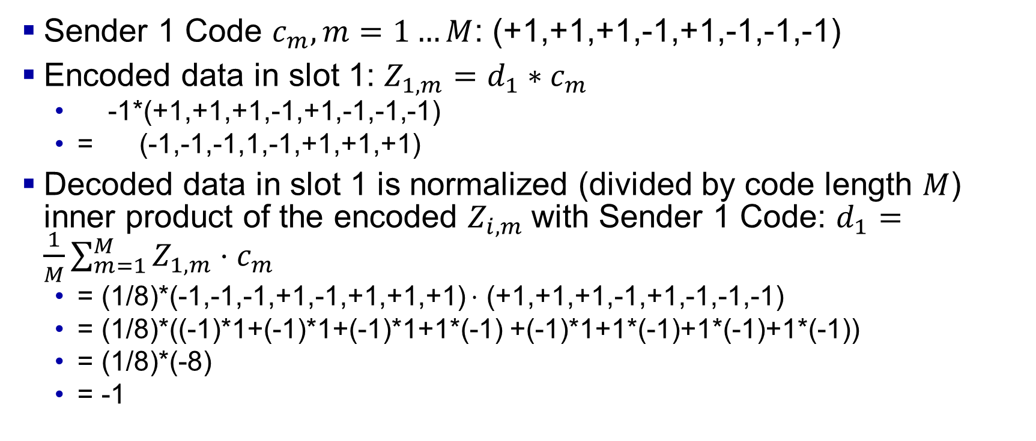
CDMA encode/decode
IMPORTANT
Sender 1 Code $c_{m}, m=1…M$: (+1,+1,+1,-1,+1,-1,-1,-1)
Encoded data in slot 1: $Z_{1,m}=d_{1}∗c_{m}$
-1*(+1,+1,+1,-1,+1,-1,-1,-1)
= (-1,-1,-1,1,-1,+1,+1,+1)
Decoded data in slot 1 is normalized (divided by code length $M$) inner product of the encoded $Z_{i,m}$with Sender 1 Code: $d_{1}=\frac{1}{M}\sum_{m=1}^{M}{Z_{1,m}}⋅c_{m}$
= (1/8)*(-1,-1,-1,+1,-1,+1,+1,+1) $⋅$ (+1,+1,+1,-1,+1,-1,-1,-1)
= (1/8)*((-1)*1+(-1)*1+(-1)*1+1*(-1) +(-1)*1+1*(-1)+1*(-1)+1*(-1))
= (1/8)*(-8)
= -1

Slide 26
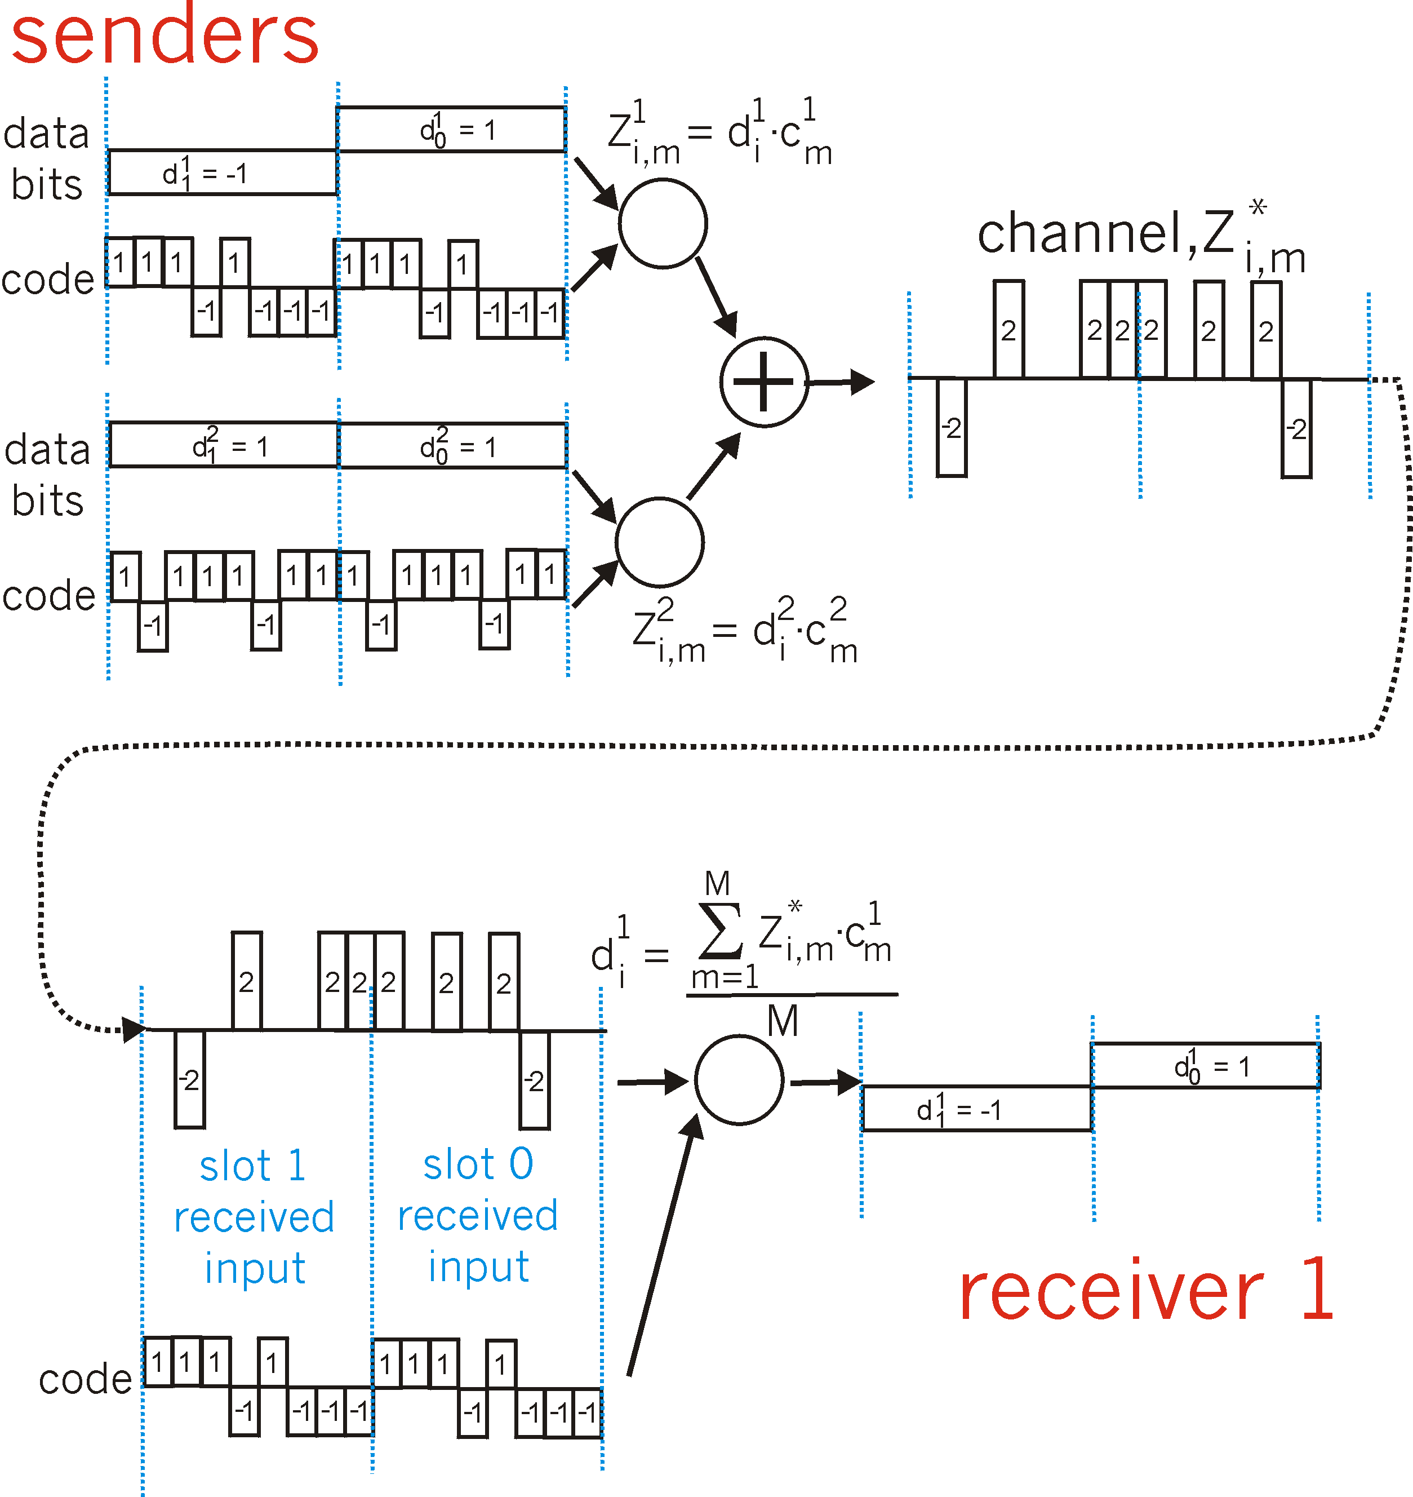
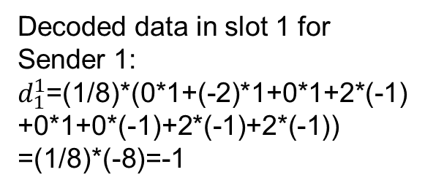
CDMA: two-sender interference
IMPORTANT
channel sums together transmissions by sender 1 and 2
Sender 1
Encoded data in slot 1:
-1*(+1,+1,+1,-1,+1,-1,-1,-1)
+ 1*(+1,-1,+1,+1,+1,-1,+1,+1)
= (0,-2,0,2,0,0,2,2)
Sender 2
using same code as sender 1, receiver recovers sender 1’s original data from summed channel data!
M=8 (# bits)
Decoded data in slot 1 for Sender 1:
$d_{1}^{1}$=(1/8)*(0*1+(-2)*1+0*1+2*(-1)
+0*1+0*(-1)+2*(-1)+2*(-1))
=(1/8)*(-8)=-1
(provided the codes for different
senders are orthogonal)

Slide 27
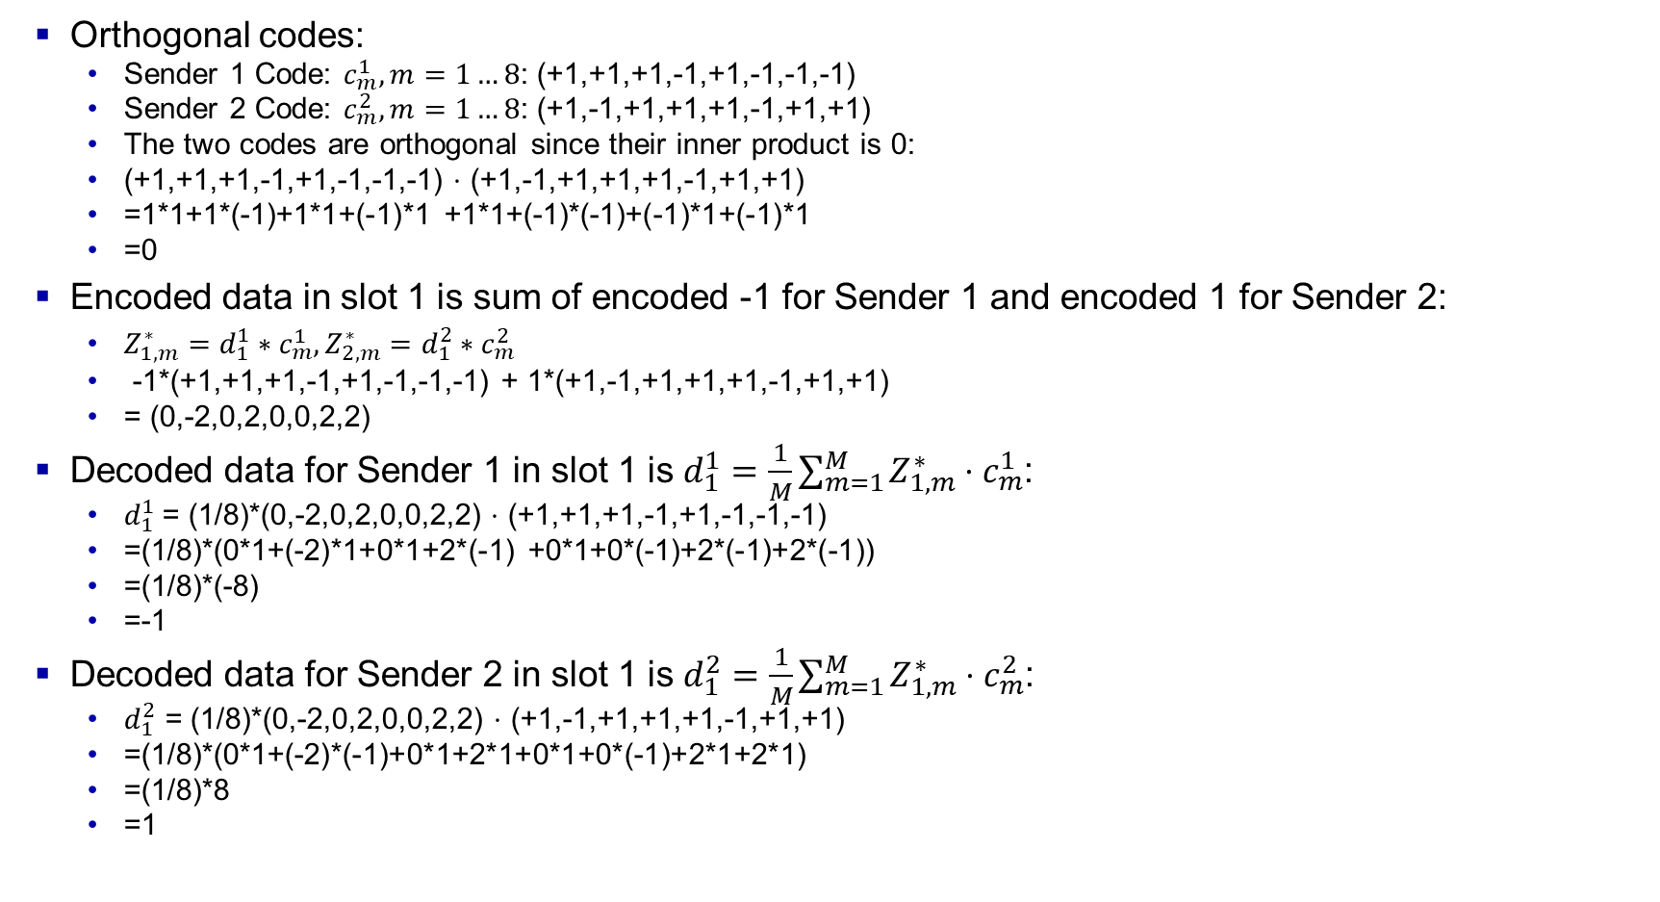
CDMA: two-sender interference
IMPORTANT
Orthogonal codes:
Sender 1 Code: $c_{m}^{1},m=1…8$: (+1,+1,+1,-1,+1,-1,-1,-1)
Sender 2 Code: $c_{m}^{2},m=1…8\text{:}$ (+1,-1,+1,+1,+1,-1,+1,+1)
The two codes are orthogonal since their inner product is 0:
(+1,+1,+1,-1,+1,-1,-1,-1) $⋅$ (+1,-1,+1,+1,+1,-1,+1,+1)
=1*1+1*(-1)+1*1+(-1)*1 +1*1+(-1)*(-1)+(-1)*1+(-1)*1
=0
Encoded data in slot 1 is sum of encoded -1 for Sender 1 and encoded 1 for Sender 2:
$Z_{1,m}^{∗}=d_{1}^{1}∗c_{m}^{1},Z_{2,m}^{∗}=d_{1}^{2}∗c_{m}^{2}$
-1*(+1,+1,+1,-1,+1,-1,-1,-1) + 1*(+1,-1,+1,+1,+1,-1,+1,+1)
= (0,-2,0,2,0,0,2,2)
Decoded data for Sender 1 in slot 1 is $d_{1}^{1}=\frac{1}{M}\sum_{m=1}^{M}{Z_{1,m}^{∗}}⋅c_{m}^{1}$:
$d_{1}^{1}$= (1/8)*(0,-2,0,2,0,0,2,2) $⋅$ (+1,+1,+1,-1,+1,-1,-1,-1)
=(1/8)*(0*1+(-2)*1+0*1+2*(-1) +0*1+0*(-1)+2*(-1)+2*(-1))
=(1/8)*(-8)
=-1
Decoded data for Sender 2 in slot 1 is $d_{1}^{2}=\frac{1}{M}\sum_{m=1}^{M}{Z_{1,m}^{∗}}⋅c_{m}^{2}$:
$d_{1}^{2}$ = (1/8)*(0,-2,0,2,0,0,2,2) $⋅$ (+1,-1,+1,+1,+1,-1,+1,+1)
=(1/8)*(0*1+(-2)*(-1)+0*1+2*1+0*1+0*(-1)+2*1+2*1)
=(1/8)*8
=1

Slide 28
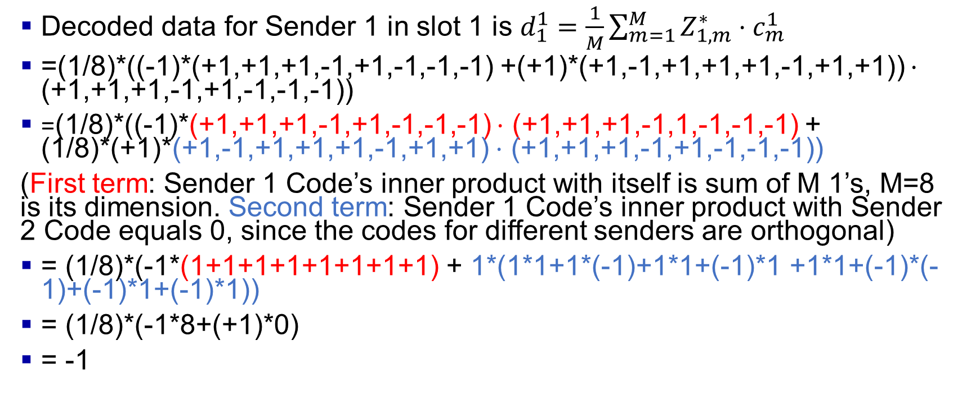
CDMA: two-sender interference: Sender 1
IMPORTANT
Decoded data for Sender 1 in slot 1 is $d_{1}^{1}=\frac{1}{M}\sum_{m=1}^{M}{Z_{1,m}^{∗}}⋅c_{m}^{1}$
=(1/8)*((-1)*(+1,+1,+1,-1,+1,-1,-1,-1) +(+1)*(+1,-1,+1,+1,+1,-1,+1,+1)) $⋅$ (+1,+1,+1,-1,+1,-1,-1,-1))
=(1/8)*((-1)*(+1,+1,+1,-1,+1,-1,-1,-1) $⋅$ (+1,+1,+1,-1,1,-1,-1,-1) + (1/8)*(+1)*(+1,-1,+1,+1,+1,-1,+1,+1) $⋅$ (+1,+1,+1,-1,+1,-1,-1,-1))
(First term: Sender 1 Code’s inner product with itself is sum of M 1’s, M=8 is its dimension. Second term: Sender 1 Code’s inner product with Sender 2 Code equals 0, since the codes for different senders are orthogonal)
= (1/8)*(-1*(1+1+1+1+1+1+1+1) + 1*(1*1+1*(-1)+1*1+(-1)*1 +1*1+(-1)*(-1)+(-1)*1+(-1)*1))
= (1/8)*(-1*8+(+1)*0)
= -1

Slide 29
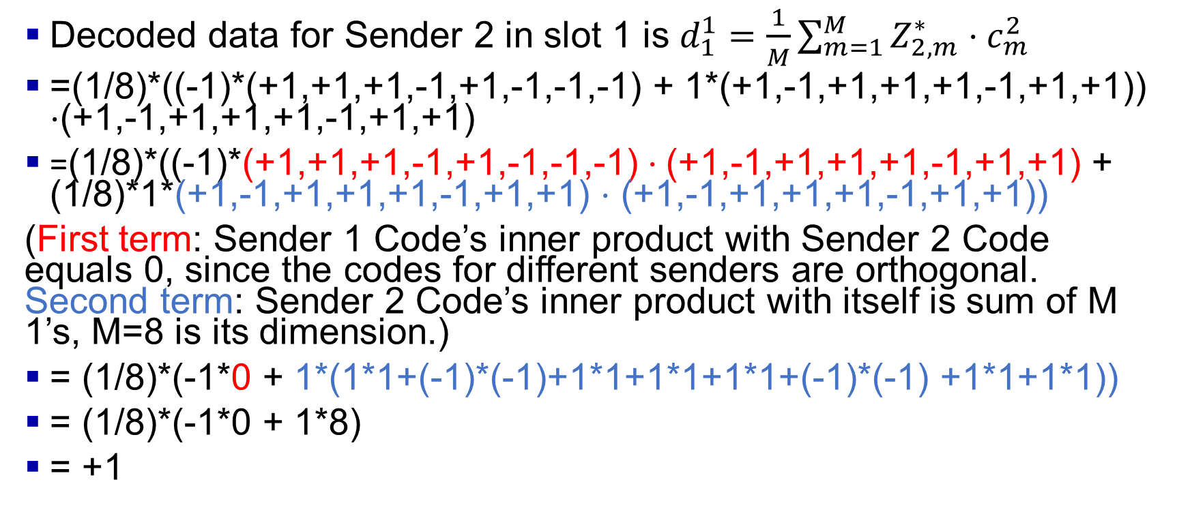
CDMA: two-sender interference: Sender 2
IMPORTANT
Decoded data for Sender 2 in slot 1 is $d_{1}^{1}=\frac{1}{M}\sum_{m=1}^{M}{Z_{2,m}^{∗}}⋅c_{m}^{2}$
=(1/8)*((-1)*(+1,+1,+1,-1,+1,-1,-1,-1) + 1*(+1,-1,+1,+1,+1,-1,+1,+1)) $⋅$(+1,-1,+1,+1,+1,-1,+1,+1)
=(1/8)*((-1)*(+1,+1,+1,-1,+1,-1,-1,-1) $⋅$(+1,-1,+1,+1,+1,-1,+1,+1) + (1/8)*1*(+1,-1,+1,+1,+1,-1,+1,+1) $⋅$ (+1,-1,+1,+1,+1,-1,+1,+1))
(First term: Sender 1 Code’s inner product with Sender 2 Code equals 0, since the codes for different senders are orthogonal. Second term: Sender 2 Code’s inner product with itself is sum of M 1’s, M=8 is its dimension.)
= (1/8)*(-1*0 + 1*(1*1+(-1)*(-1)+1*1+1*1+1*1+(-1)*(-1) +1*1+1*1))
= (1/8)*(-1*0 + 1*8)
= +1

Slide 30
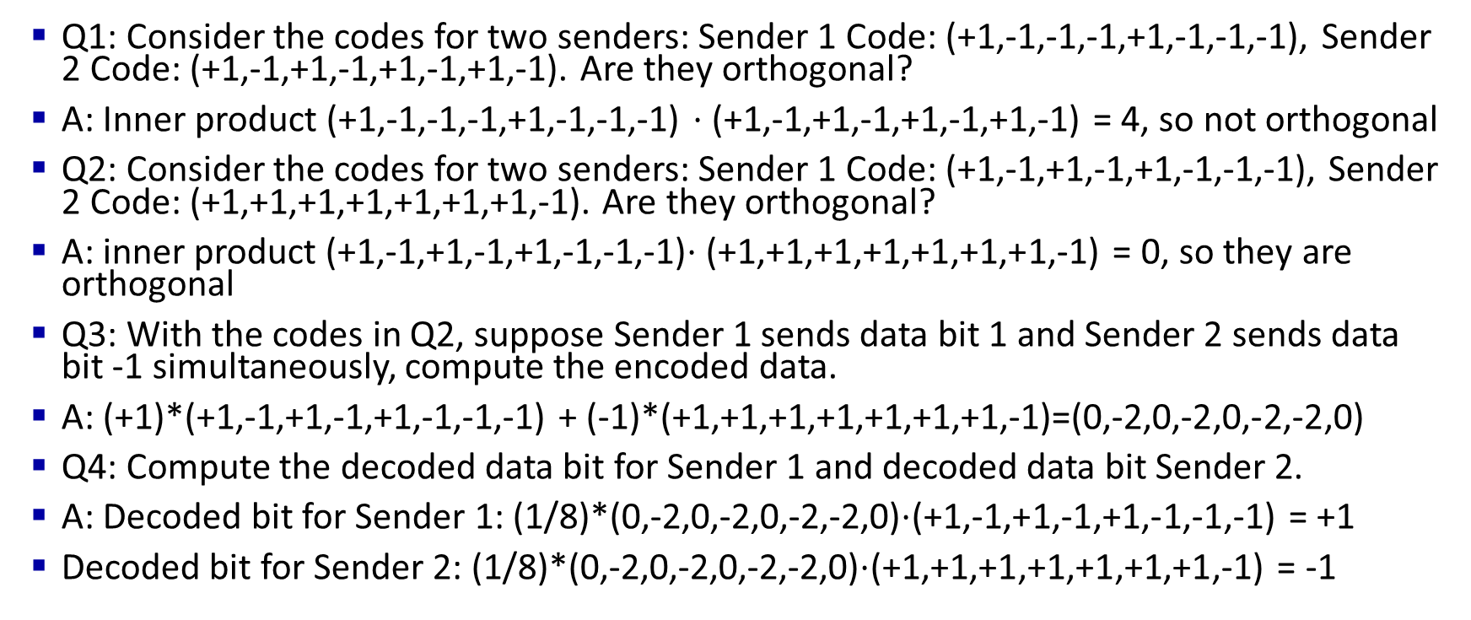
Quiz 1 CDMA
IMPORTANT
Q1: Consider the codes for two senders: Sender 1 Code: (+1,-1,-1,-1,+1,-1,-1,-1), Sender 2 Code: (+1,-1,+1,-1,+1,-1,+1,-1). Are they orthogonal?
A: Inner product (+1,-1,-1,-1,+1,-1,-1,-1) $⋅$(+1,-1,+1,-1,+1,-1,+1,-1) = 4, so not orthogonal
Q2: Consider the codes for two senders: Sender 1 Code: (+1,-1,+1,-1,+1,-1,-1,-1), Sender 2 Code: (+1,+1,+1,+1,+1,+1,+1,-1). Are they orthogonal?
A: inner product (+1,-1,+1,-1,+1,-1,-1,-1)$⋅$(+1,+1,+1,+1,+1,+1,+1,-1) = 0, so they are orthogonal
Q3: With the codes in Q2, suppose Sender 1 sends data bit 1 and Sender 2 sends data bit -1 simultaneously, compute the encoded data.
A: (+1)*(+1,-1,+1,-1,+1,-1,-1,-1) + (-1)*(+1,+1,+1,+1,+1,+1,+1,-1)=(0,-2,0,-2,0,-2,-2,0)
Q4: Compute the decoded data bit for Sender 1 and decoded data bit Sender 2.
A: Decoded bit for Sender 1: (1/8)*(0,-2,0,-2,0,-2,-2,0)$⋅$(+1,-1,+1,-1,+1,-1,-1,-1) = +1
Decoded bit for Sender 2: (1/8)*(0,-2,0,-2,0,-2,-2,0)$⋅$(+1,+1,+1,+1,+1,+1,+1,-1) = -1

Slide 31
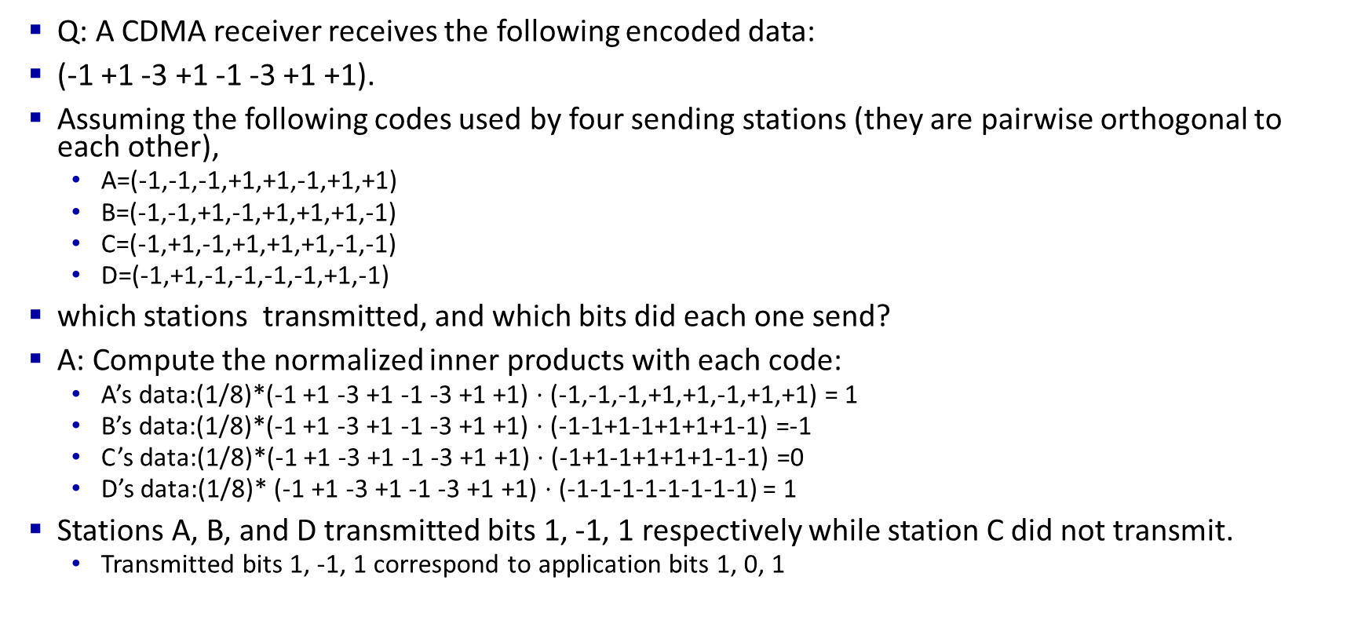
Quiz 2 CDMA
IMPORTANT
Q: A CDMA receiver receives the following encoded data:
(-1 +1 -3 +1 -1 -3 +1 +1).
Assuming the following codes used by four sending stations (they are pairwise orthogonal to each other),
A=(-1,-1,-1,+1,+1,-1,+1,+1)
B=(-1,-1,+1,-1,+1,+1,+1,-1)
C=(-1,+1,-1,+1,+1,+1,-1,-1)
D=(-1,+1,-1,-1,-1,-1,+1,-1)
which stations transmitted, and which bits did each one send?
A: Compute the normalized inner products with each code:
A’s data:(1/8)*(-1 +1 -3 +1 -1 -3 +1 +1) $⋅$ (-1,-1,-1,+1,+1,-1,+1,+1) = 1
B’s data:(1/8)*(-1 +1 -3 +1 -1 -3 +1 +1) $⋅$ (-1-1+1-1+1+1+1-1) =-1
C’s data:(1/8)*(-1 +1 -3 +1 -1 -3 +1 +1) $⋅$ (-1+1-1+1+1+1-1-1) =0
D’s data:(1/8)* (-1 +1 -3 +1 -1 -3 +1 +1) $⋅$ (-1-1-1-1-1-1-1-1) = 1
Stations A, B, and D transmitted bits 1, -1, 1 respectively while station C did not transmit.
Transmitted bits 1, -1, 1 correspond to application bits 1, 0, 1

